Slide 1

Trans_Pro –Cargo service application
PRESENTED BY:
ASAD NABI BAKHSH(SP22-BCS-025)
TANIA QAYYUM(SP22-BCS-008)
QURAT UL AIN(SP22-BCS-007)

Slide 2
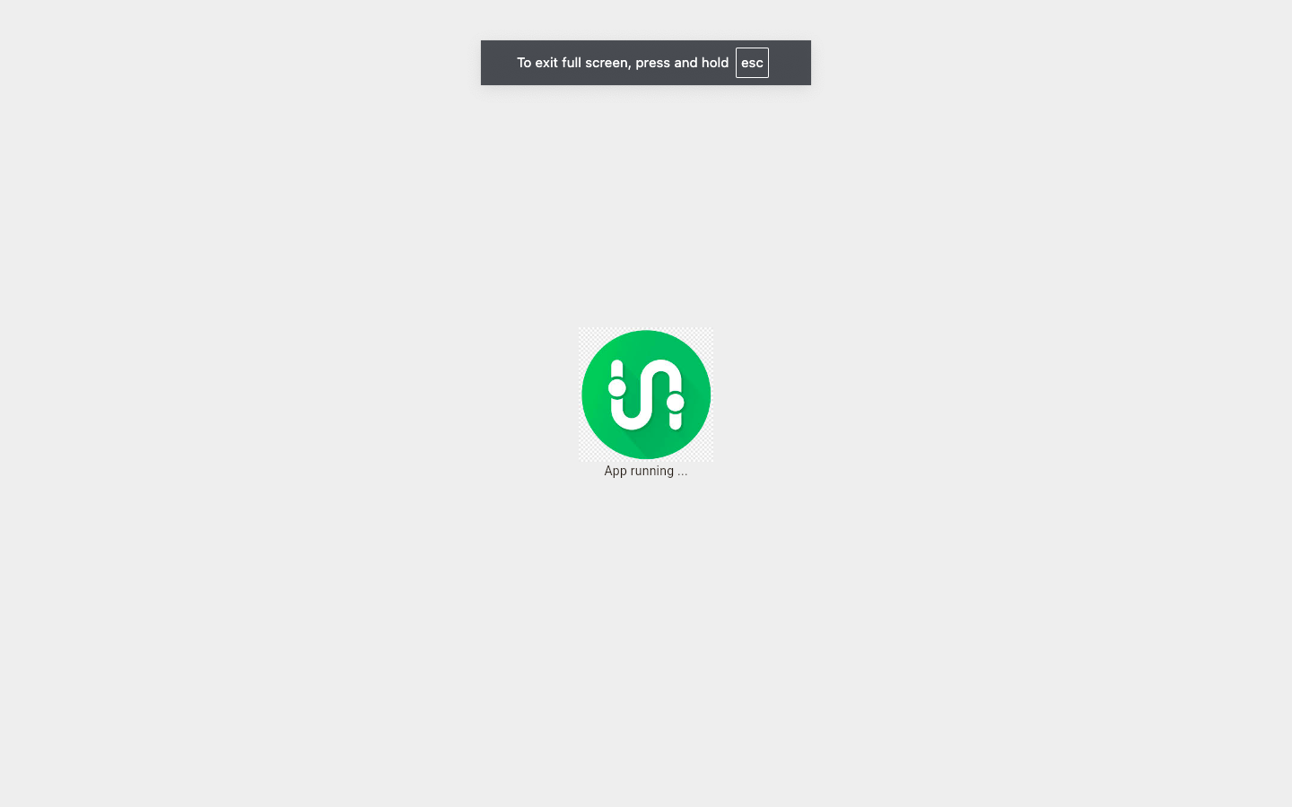
Splash screen
A splash screen is the initial screen that appears when a mobile application is launched. It displays the app's logo, brand name, or an introductory animation for a few seconds before transitioning to the main content of the app.

Slide 3
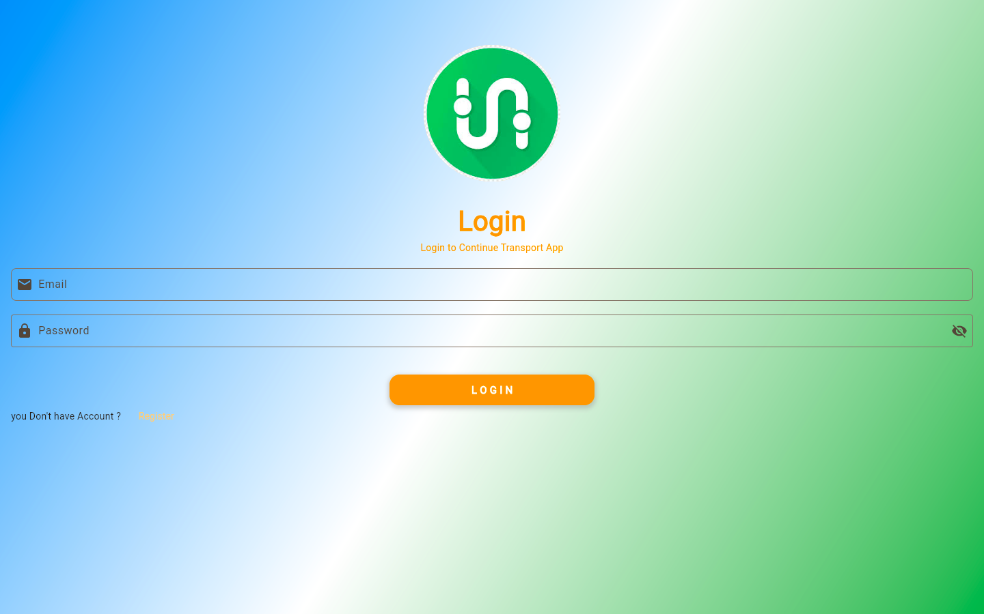
Login form

Slide 4
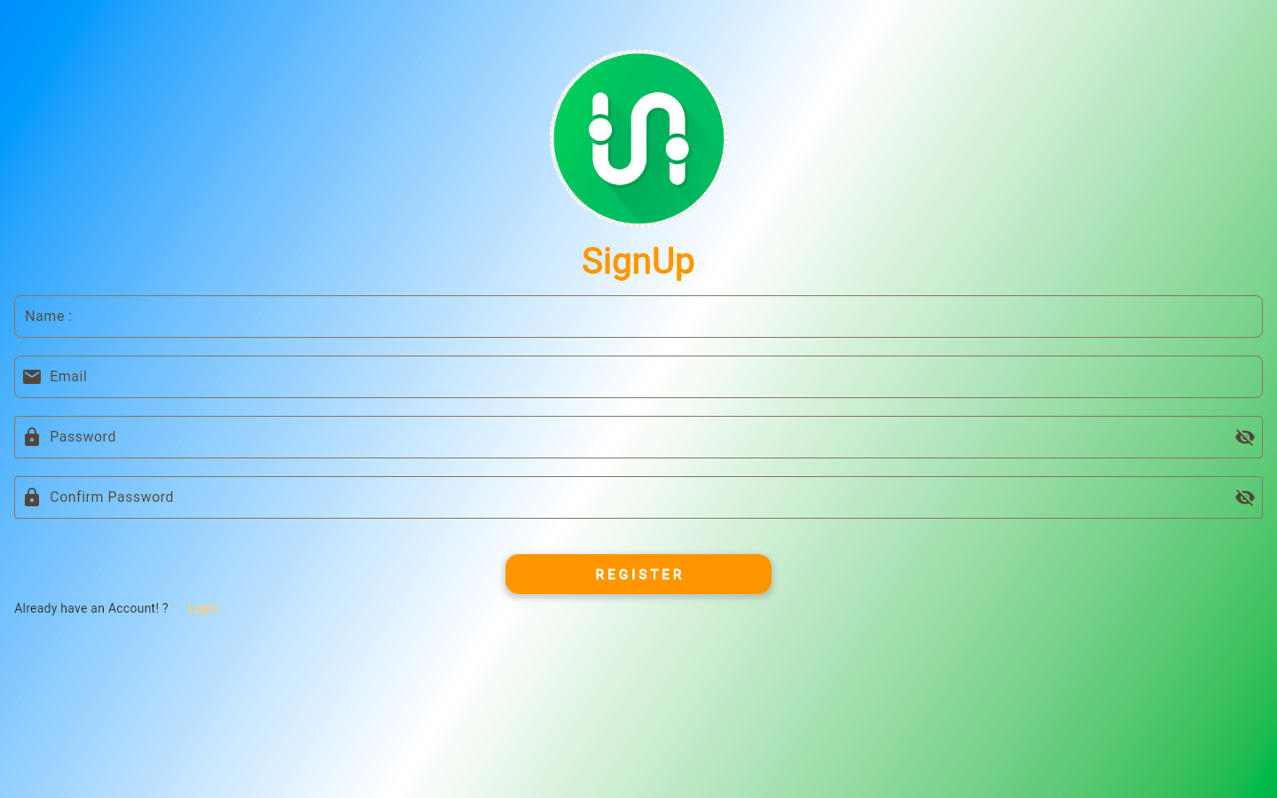
Sign-up form

Slide 5
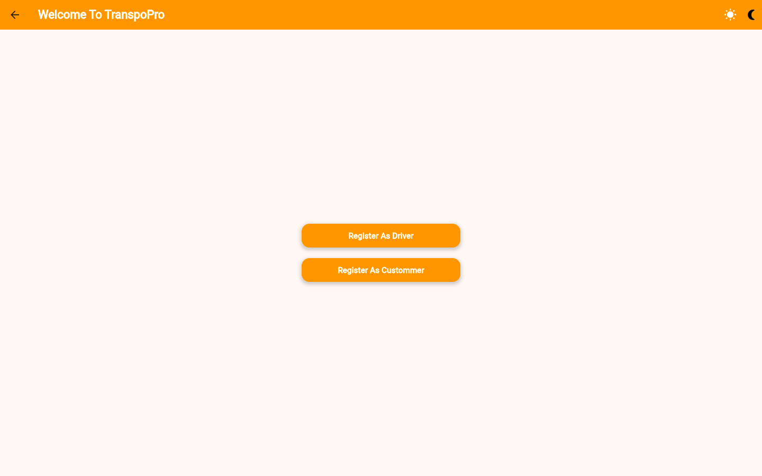
Home screen
Home Screen serves as the main entry point for users. In home screen of our app users can choose between registering as a Driver or Customer.

Slide 6
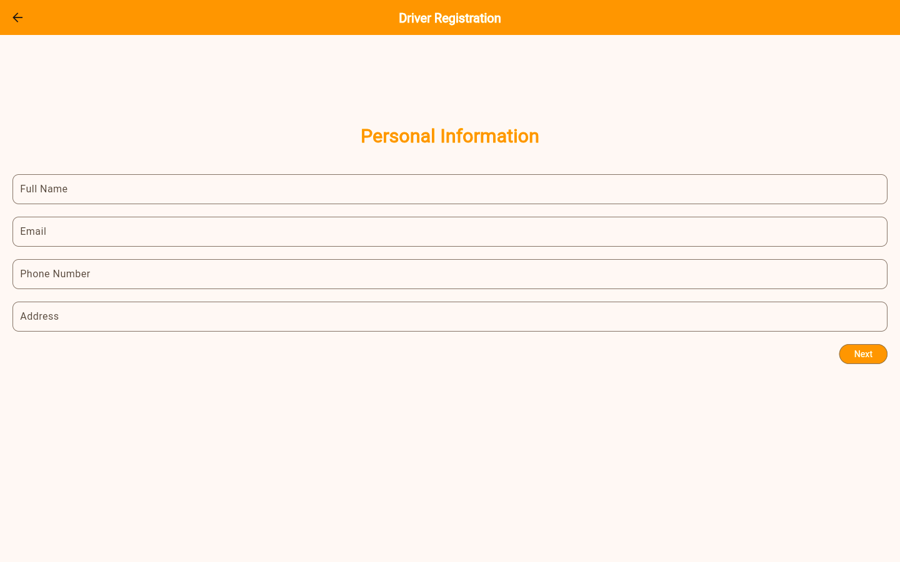
Driver's Registration Form
To allow drivers to register and provide essential details for the transportation services.
Key Fields:
Name
Email
Phone Number
Address
License Number
Vichelle Details.

Slide 7
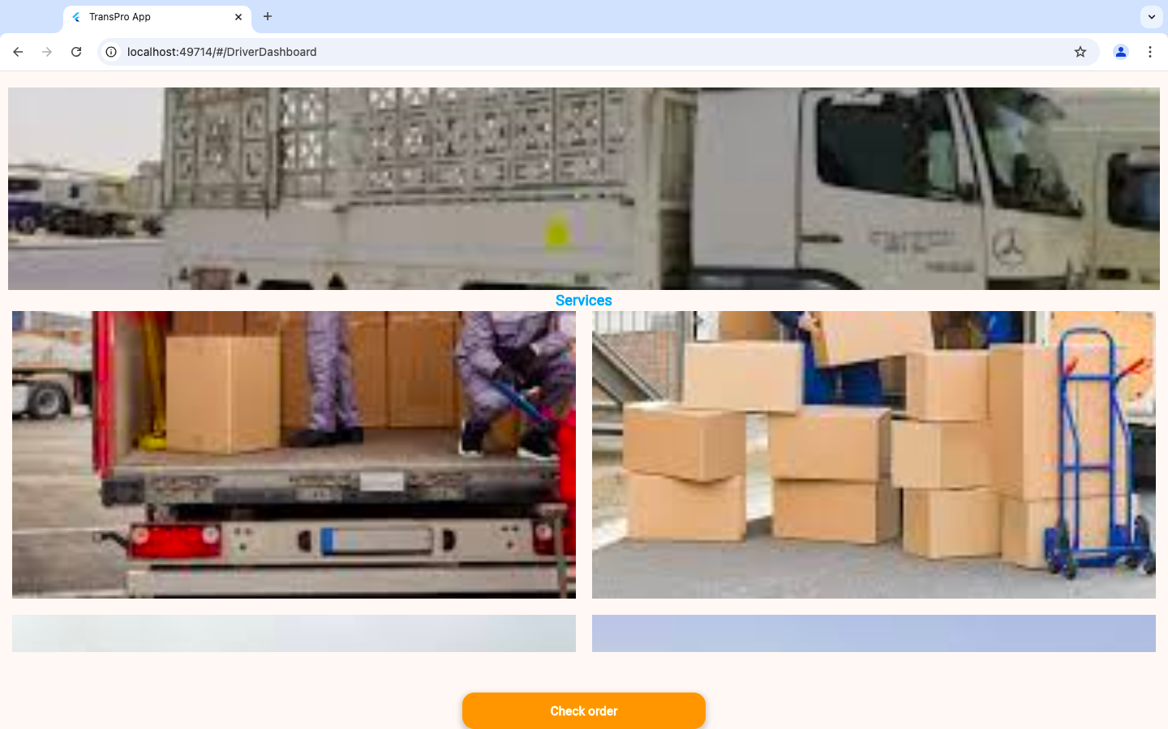
Driver's Dashboard

Slide 8
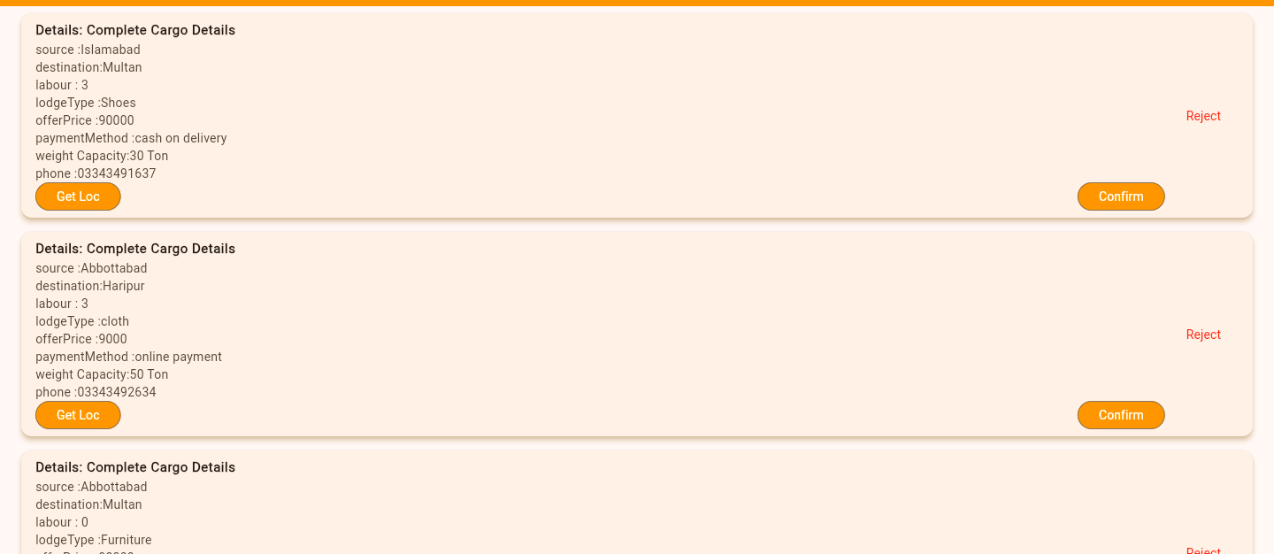
Driver Notification Screen

Slide 9
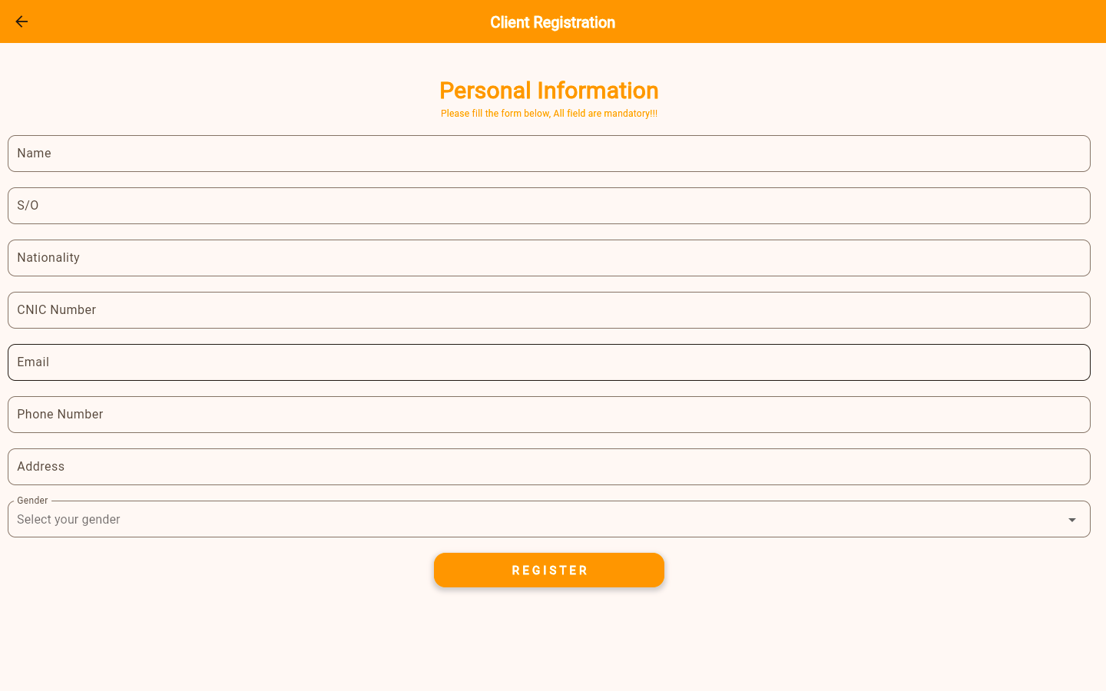
Client's Registration Form
To allow clients to register and provide essential details for the transportation services.
Key Fields:
Name
Email
Phone Number
Address
Gender

Slide 10
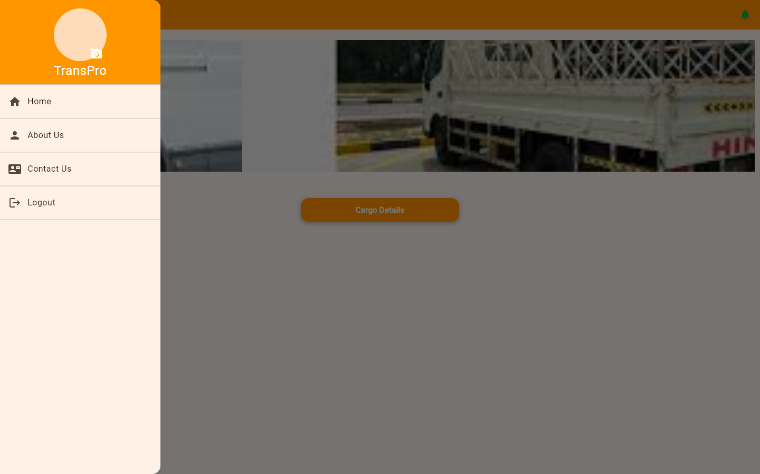
Client's Dashboard

Slide 11
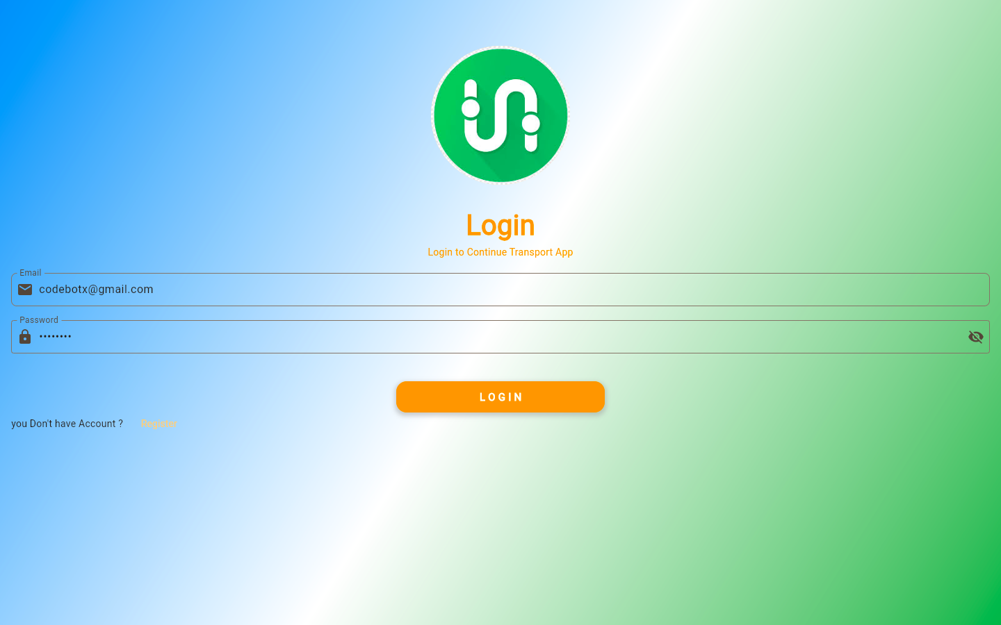
admin login
The Admin Login screen allows administrators to securely log in and access the app's control panel. Once credentials are verified, the admin gains access to the dashboard.

Slide 12
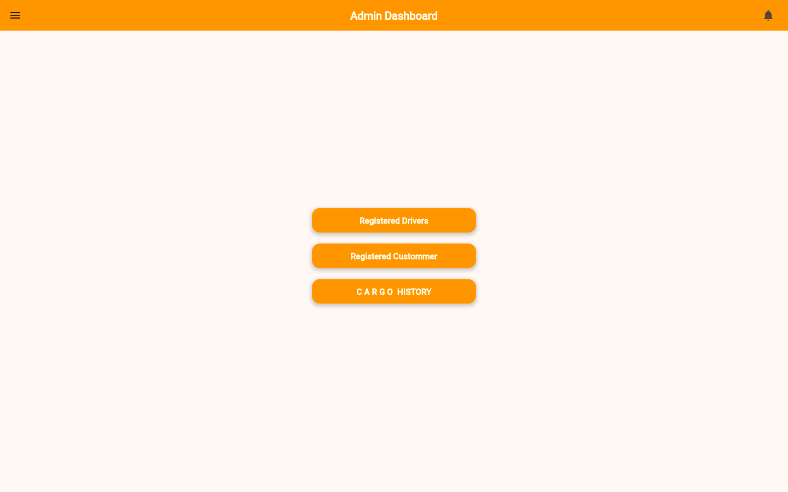
Admin's Dashboard

Slide 13
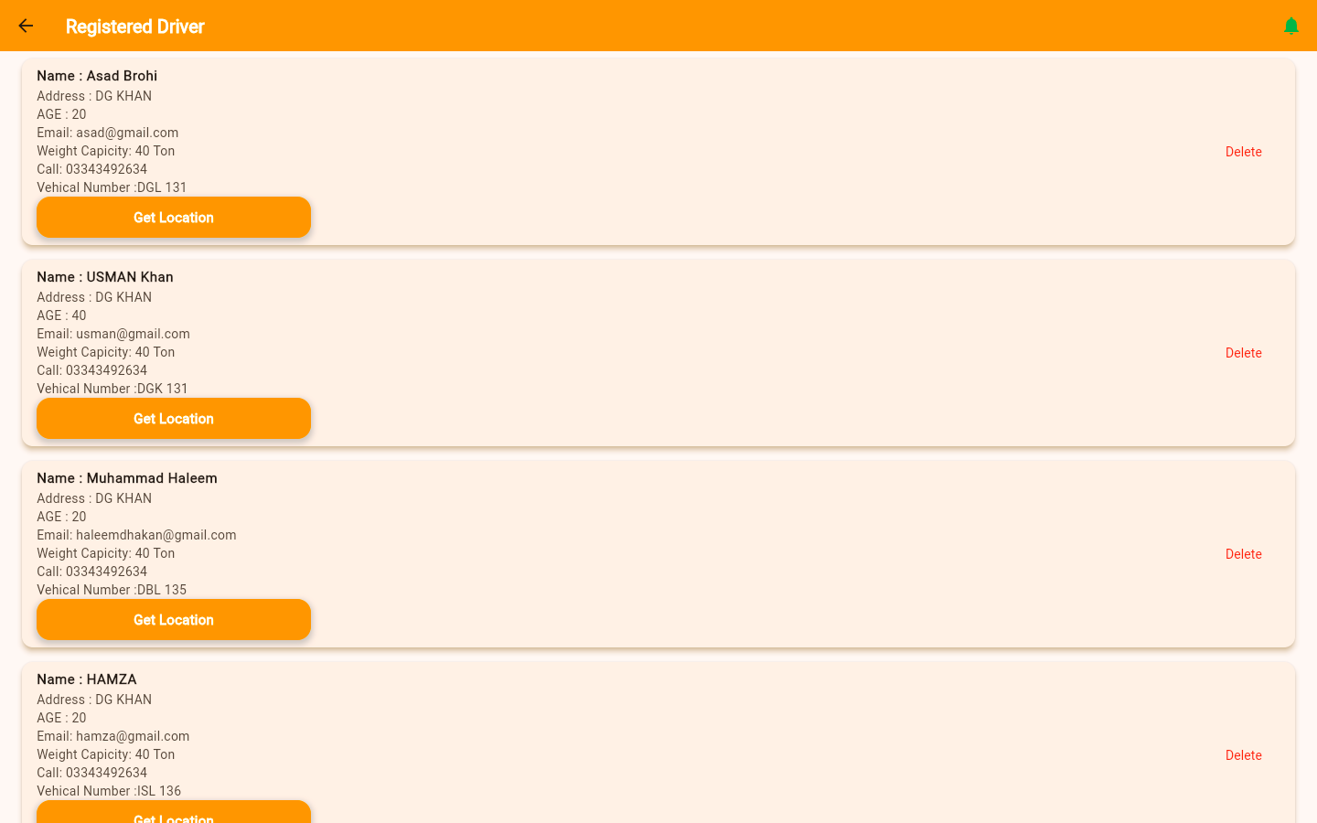
Registered drivers

Slide 14
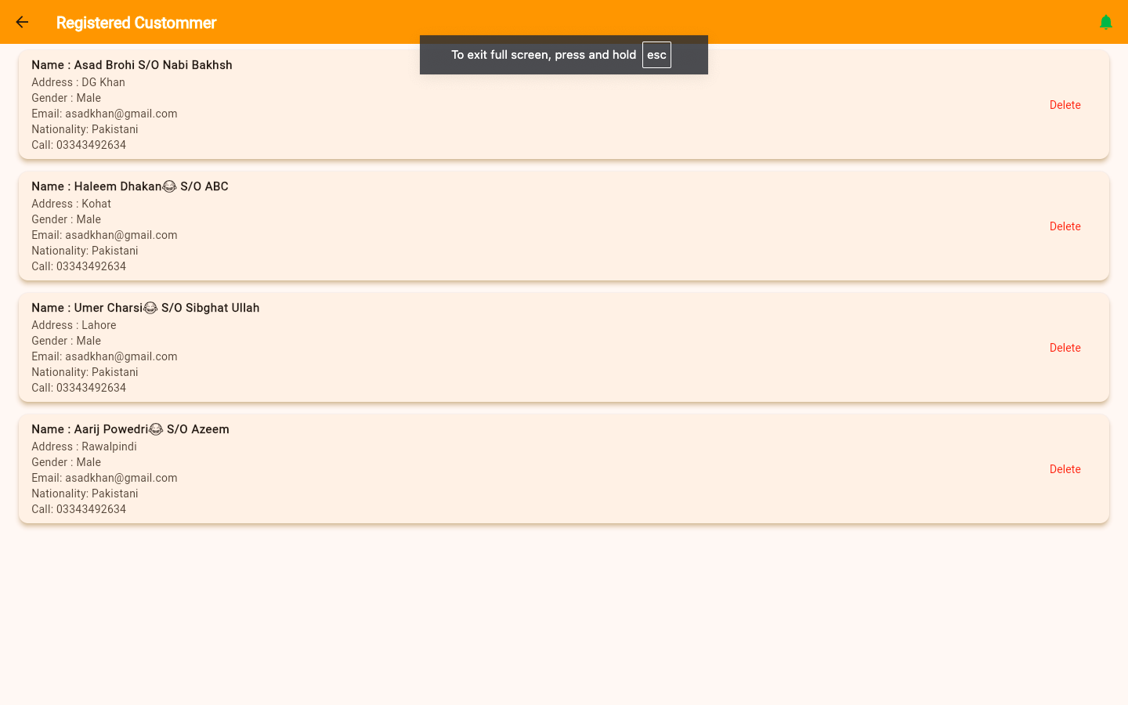
Registered customers

Slide 15
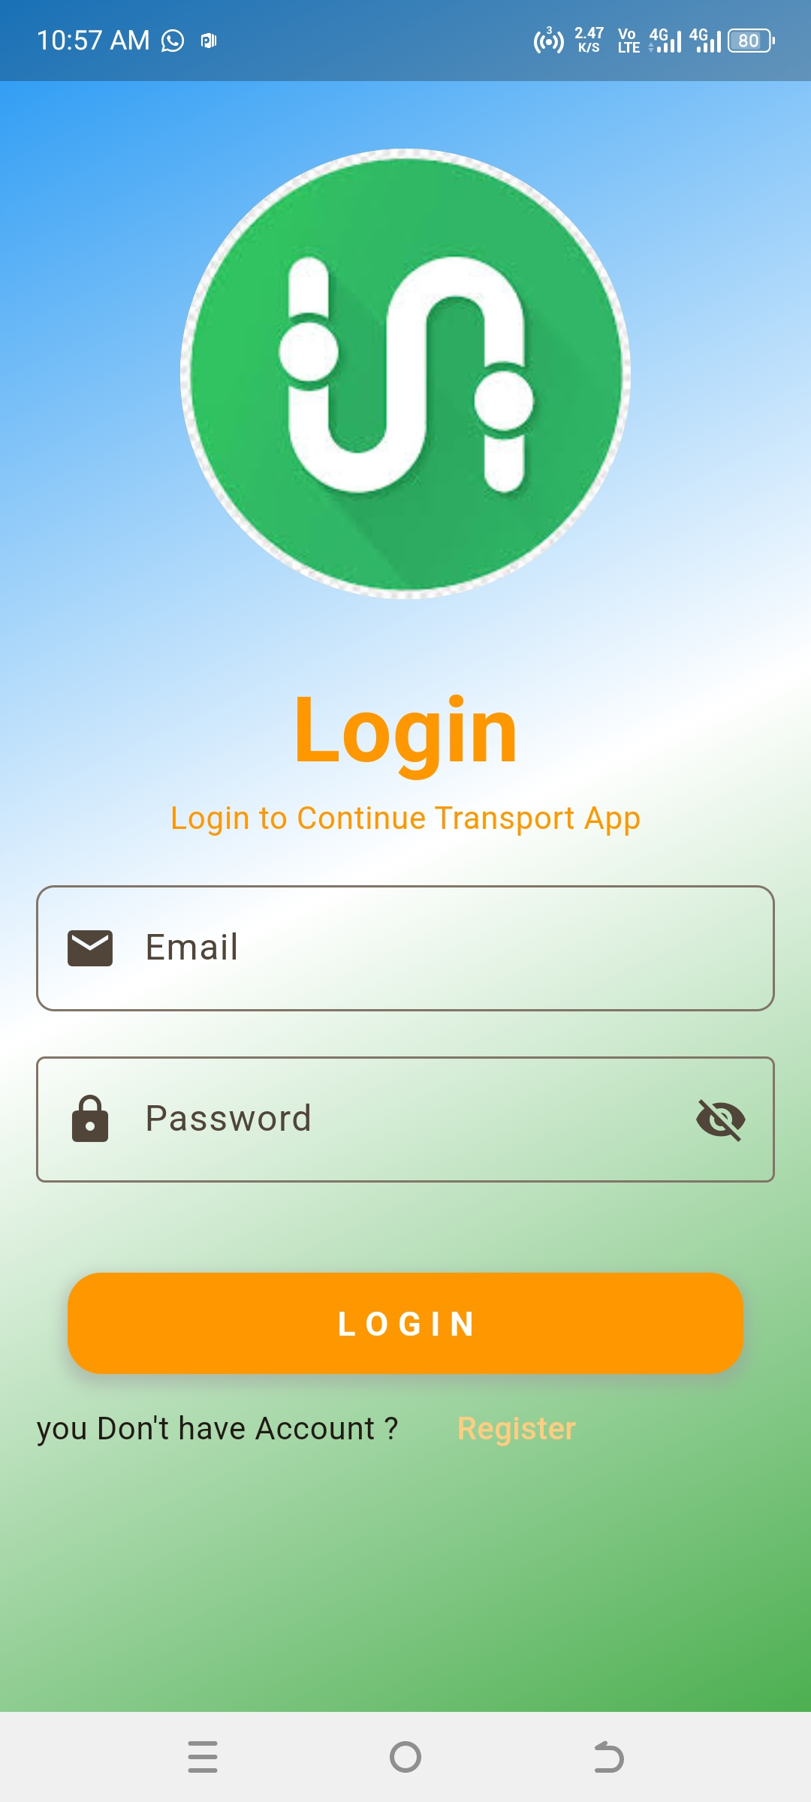
Mobile View

Slide 16
Project also use firebase authentication and Firestore database ….

